Slide 1


Unit 2
Reviewing the HHFA data analysis platform outputs
Notes:
Welcome to Unit 2 of Module 3.
In this module we will look at how to review the HHFA data analysis platform outputs.

Slide 2
By the end of this unit, you will:
list the stages in the review of the analysis platform outputs
explain how to look at the structure of an indicator table
describe the steps for understanding what the indicators reveal
explain how to describe and summarize the HHFA findings
Notes:
By the end of this unit, you will:
list the stages in the review of the analysis platform outputs;
explain how to look at the structure of an indicator table;
describe the steps for understanding what the indicators reveal; and
explain how to describe and summarize the HHFA findings.

Slide 3
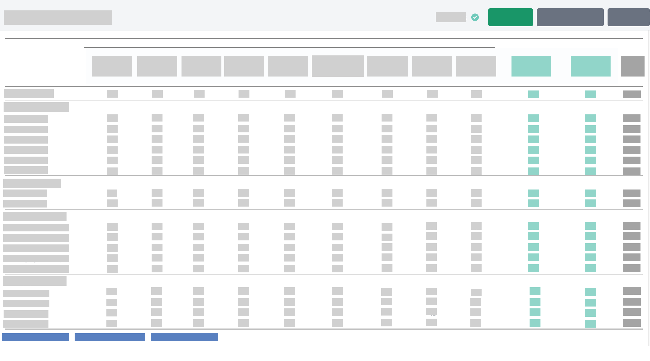
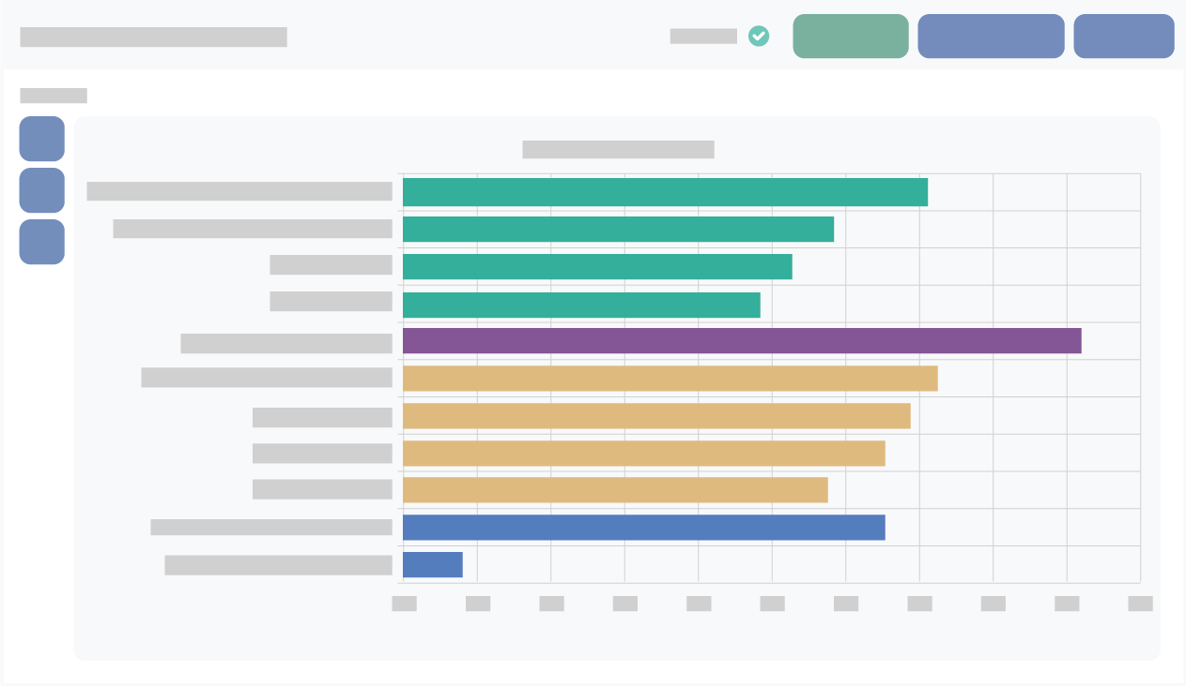

HHFA data analysis platform outputs
The HHFA data analysis platform presents the findings of a country HHFA in a set of standard tables and graphs called the analysis platform outputs. Maps are sometimes also included.
Notes:
The HHFA data analysis platform presents the findings of a country HHFA in a set of standard tables and graphs called the analysis platform outputs. Maps are sometimes also included.

Slide 4

HHFA data analysis platform outputs
Review of the analysis platform outputs involves three stages:
1.
Understanding the structure of the outputs
2.
Understanding what the data reveal
3.
Describing and summarizing the findings
We will now look at how the three stages can be used to review an indicator table.
Notes:
A review of the analysis platform outputs involves three stages:
Stage 1: Understanding the structure of the outputs;
Stage 2: Understanding what the data reveal; and
Stage 3: Describing and summarizing the findings.
Each stage includes a number of steps.
We will now look at how the three stages can be used to review an indicator table.

Slide 5
1. Understanding the structure of the outputs
Stage 1
Understanding the structure of the indicator table
1.1
table title
1.2
indicator prefix
1.3
column headings
1.4
row headings
1.5
table denominator
1.6
number of facilities in indicator denominators
Notes:
Stage 1, understanding the structure of the indicator table, involves examining:
the table title;
the indicator prefix;
the column headings;
the row headings;
the table denominator (all facilities, or only those facilities offering a specific service); and
the numbers of facilities in the indicator denominators.

Slide 6
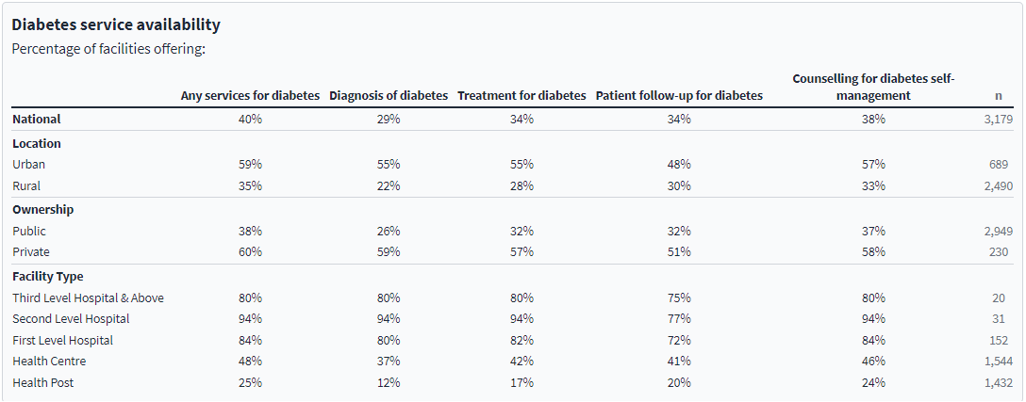
Understanding the structure of the indicator table
Table title
Indicator names
n (number of facilities)
Prefix for all indicators in the table
Stratifier variables
Strata
Notes:
Let’s look at this in the platform.
The table title provides information on the service or programme (e.g. diabetes)
The indicator prefix provides the first part of the name for all the indicators in the table, e.g. “Percentage of facilities offering:”.
The column headings show the indicator names.
The row headings refer to the stratifier variables selected for the analysis, and their strata.
n represents the number of facilities in the denominators used to calculate the indicators.

Slide 7
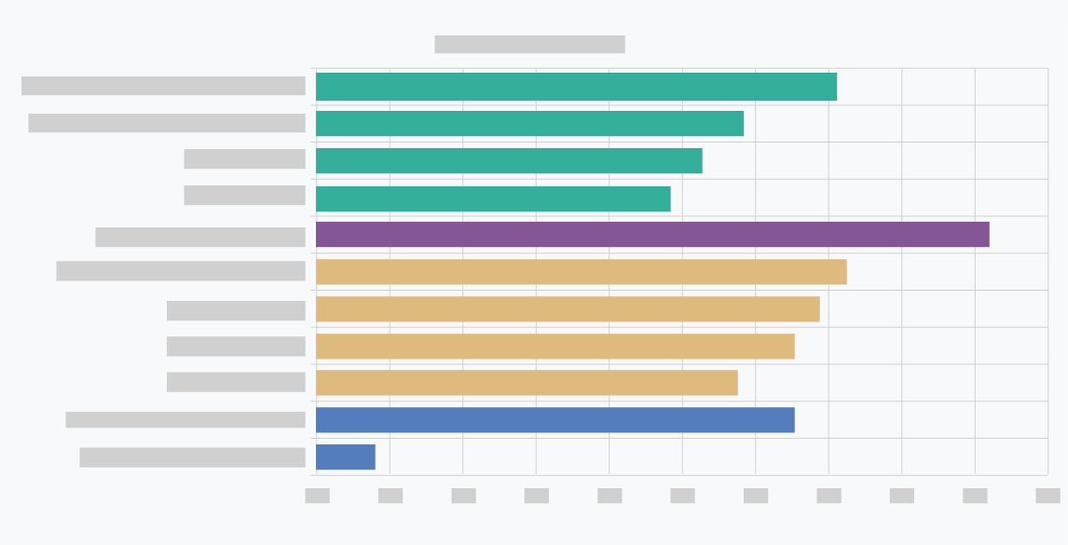
2. Understanding what the data reveal
Stage 2
Understanding what the data reveal
2.1
indicator names
2.2
indices
2.3
individual indicators
2.4
patterns
2.5
linkages between related tables
2.6
linkages across the service delivery system
Notes:
Stage 2, understanding what the data reveal, involves examining:
the indicator names;
the indices; and
the individual indicators.
As well as looking for:
any patterns in the data;
any linkages between related tables; and
any linkages across the service delivery system.

Slide 8
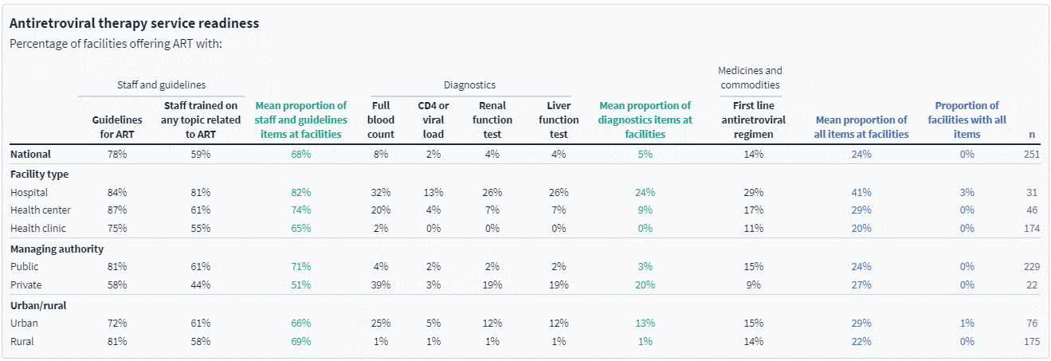
Indicator names
Indicator names
Notes:
Looking at the indicator names gives a quick idea about the kind of information included in the table.
In this case, the indicators provide information about the presence of key items needed for delivering antiretroviral therapy services, such as:
guidelines;
trained staff;
various diagnostic tests; and
first line antiretroviral medicines.

Slide 9
Indices
Let’s look at how the individual indicator values contribute to the indices.
Notes:
This table shows (in blue) the:
overall readiness index of the table (the mean proportion of all items available in facilities); and
the “with all items” index (the proportion of facilities with all items).
It also shows (in green) the domain indices for the two domains of:
Staff and guidelines; and
Diagnostics.
Let’s look at how the individual indicator values contribute to the indices.

Slide 10
Indices
Overall readiness index
Notes:
In this example, looking at the national level data, the values for the two Staff and guidelines indicators are 78% and 59%, with the average for the domain index being 68%.
The values for the Diagnostics indicators are low, and so the domain index is also low at 5%.
In spite of the fairly high values of the Staff and guidelines indicators, the low values of the Diagnostics indicators and the Medicines and commodities indicator result in an overall readiness index of only 24%.

Slide 11
Individual indicators
Stratifier variables
Strata
77%
Outlier
requires further investigation
Notes:
A table may contain multiple indicators and several stratifier variables and strata.
It is therefore helpful to take a systematic approach to reviewing the indicators.
Start by looking quickly at all the indicator values across the table and assess if they seem plausible.
Are there any exceptionally high or low values?
Such values are called outliers. An outlier may point to a data error but may also point to unusual, but real and interesting findings.
An outlier always requires further investigation.
For example, 77% of rural facilities are shown here to have the capacity to provide liver function tests. Does this seem plausible, especially when compared to the other data in the table?

Slide 12
Individual indicators
Note minimum and maximum values.
Compare the values within each stratifier with the national average.
77%
Compare the values with any available targets that are realistic/relevant.
Notes:
Next, look at each of the indicators in turn.
Let’s look at “Full blood count”, as an example. Note the national level value.
In this example, only 8% of all facilities offering antiretroviral therapy services have the capacity to provide full blood count diagnostic tests.
Within each of the stratifier variables, note the minimum and maximum values. For example, under the “facility type” stratifier, the maximum value is 32% for hospitals and the minimum is 2% for Health clinics.
Compare the values within each stratifier with the national average. A substantially higher percentage of hospitals, private facilities and urban facilities have the capacity to provide full blood counts compared with the national average. Is this expected?
You should also compare the values with any available targets that are realistic and relevant to the country context.

Slide 13
Individual indicators
Compare the performance of the different indicators.
77%
Compare findings of previous facility surveys with current findings.
Notes:
Now compare the performance of the different indicators, first within each domain, and then among domains.
Do some indicators show better performance than others?
In this example, the Staff and guidelines indicators show better performances than other indicators.
For selected indicators, the findings of the previous facility surveys should be compared with those of the current HHFA, if comparable methods and indicators were used.

Slide 14
Individual indicators
Most HHFA indicators are expressed as percentages.
It is also important to consider the absolute numbers.
Example: Country A
Goal: Increase antiretroviral therapy availability from 60% to 80%
Total country facilities = 500
Total country facilities = 5 000
Scale-up needs fewer resources
Scale-up needs more resources
100 facilities need to add the service
1 000 facilities need to add the service
Notes:
Note that while most HHFA indicators are presented as percentages, it is also important to consider the absolute numbers.
Let’s look at an example for Country A:
60% of facilities in the country currently offer antiretroviral therapy services.
Country A wants to increase this percentage to 80%.
If the total number of facilities in the country is 500, scaling up the services requires fewer resources, as only 100 facilities would need to add the service.
However, if the total number of facilities is 5000, scaling up the services requires more resources, as 1000 facilities would need to add the service.)

Slide 15
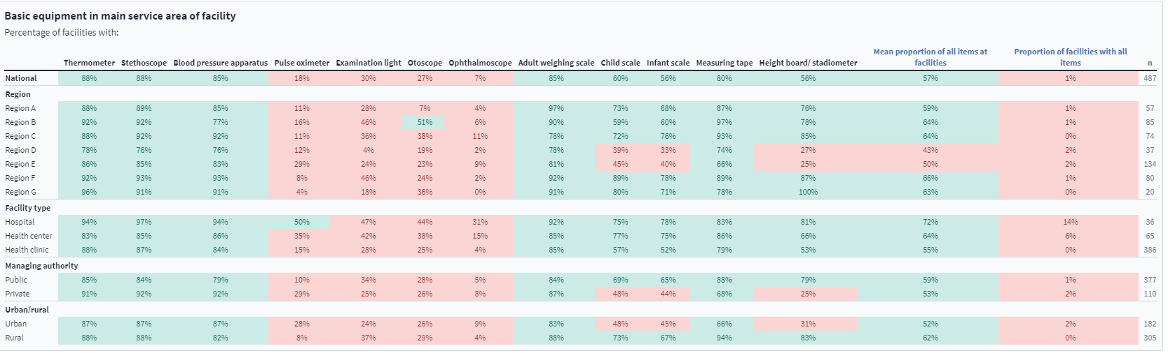
Patterns
Indicators (Green: 50% or higher)
Indicators (Pink: below 50%)
Do some indicators show poor performances across multiple stratifiers?
Does a particular region show poor performance across multiple indicators?
Notes:
Look for patterns emerging across indicators or strata.
For example:
Do some indicators consistently show poor performances across multiple stratifiers?
Does a particular region show poor performance across multiple indicators?
In this example, the conditional formatting shows indicators with a value of 50% or higher in green, and those with a value below 50% in pink.
You can see that the indicators for pulse oximeter, examination light, otoscope and ophthalmoscope show poor performance across all stratifier variables and strata.

Slide 16
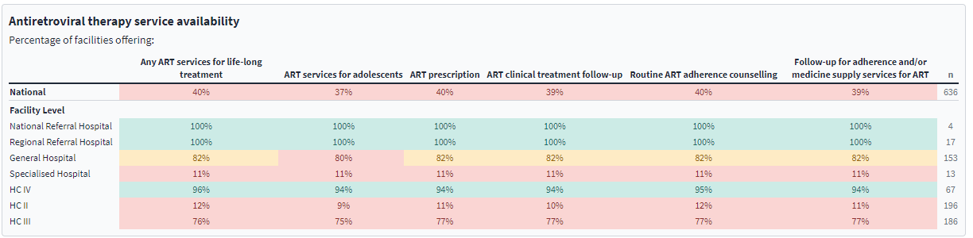
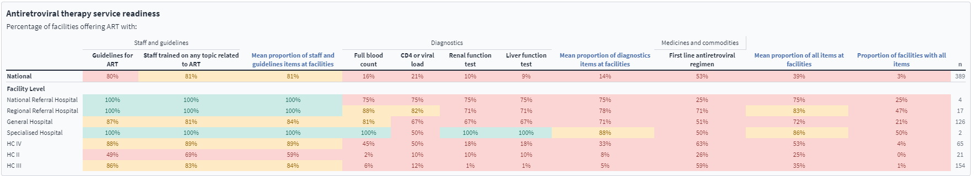
Links between related tables
Indicators: 81 to 90% = yellow
Indicators: greater than 90% = green
Indicators: 0 to 80% = pink
Is performance satisfactory for both? Are there differences?
Notes:
It is also important to review the various tables within a single programme together and to compare them for links.
For example, compare the availability and readiness tables.
Is performance satisfactory for both service availability and readiness, or are there differences?
In this example, conditional formatting is used for the following categories:
0 to 80%: pink;
81 to 90%: yellow; and
greater than 90%: green.
Note that the categorization used for conditional formatting in this example is arbitrary. Appropriate categories should be determined based on the country context.

Slide 17
Links between related tables
Levels of service availability
n (number of facilities)
Availability of diagnostic tests and first line ARVs
Notes:
In the availability table, the highest levels of service availability are in national referral hospitals, regional referral hospitals and health centre four facilities, followed by general hospitals.
Note, however, that n is much lower for national and regional referral hospitals than for health centre four and general hospitals.
In the readiness table, we see that the availability of diagnostic tests and 1st line ARVs is lower than desired across multiple facility levels.

Slide 18


Linkages across the service delivery system
Health systems consist of multiple interlinked programmes and subsystems.
Important: maintain an overview across programmes to identify common patterns or differences.
Example
Are there:
differences in the availability of key services?
similarities in the availability/readiness of services?
Notes:
Health systems consist of multiple interlinked programmes and subsystems.
Therefore, it is important to maintain an overview across multiple programmes and service components to identify common patterns or differences.
For example:
Are there differences in the availability of key services?
Are there similarities in the availability and readiness of certain services?
It is important to identify these issues, as they may have implications for the recommendations of the final HHFA survey report.

Slide 19
Linkages across the service delivery system
Availability of the service
Overall readiness index of the service
HIV |  | TB |  | Malaria |  | ANC |  | Family planning services
HIV testing and counselling services | Mean proportion of all items at facilities | Any TB services | Mean proportion of all items at facilities | Any malaria services | Mean proportion of all items at facilities | Antenatal care services | Mean proportion of all items at facilities | Family planning services | Mean proportion of all items at facilities
95% | 74% | 71% | 40% | 99% | 68% | 92% | 60% | 95% | 67%
Next step: look at domain indices and readiness indicators for each program.
Notes:
This slide shows the availability of 5 key services along with the overall readiness index for each service.
In this example, we see higher availability of HIV testing, malaria, antenatal care and family planning services, compared with TB services.
We also see that the readiness index (the mean proportion of all items at facilities) is lowest for TB, at 40%.
Furthermore, the readiness indices are relatively low compared with availability across all 5 programmes.
The next step would involve looking at the domain indices and readiness indicators for each of the programmes, to find out if there are similar problems across all the programmes.

Slide 20

3. Describing and summarizing the findings
Stage 3
Describing and summarizing the findings
3.1
systematically documenting identified issues
3.2
summarizing key findings
Notes:
After a careful review of the tables and their indicators, we come to Stage 3, Describing and summarizing the findings.
This stage involves:
systematically documenting the issues identified during the data review process; and
summarizing the key findings.

Slide 21
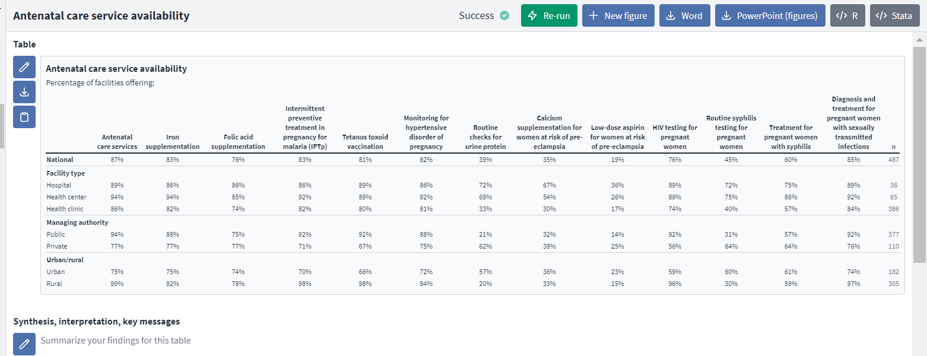
3. Describing and summarizing the findings
Box to insert findings
Notes:
The data analysis platform provides a box below each table or graph where analysts can insert findings.
Selected key findings for each table should be documented here, guided by the points suggested in Stage 2.

Slide 22
Summarize key findings
An HHFA table may yield a large amount of information/a long description. Therefore:
For each table/group of tables, select a few key findings that will help to identify conclusions, or that need further investigation.
This documentation describes the data and key findings but does not try to explain them.
Finding explanations is addressed during the interpretation phase. (Module 4)
Notes:
A single HHFA table may yield a large amount of information and a potentially lengthy description.
Therefore, it is useful to select for each table, or group of related tables, a few key findings that will help to identify the conclusions and recommendations for the HHFA report, or that require further investigation.
Note that this initial documentation process describes what the data show and highlights key findings, but does not try to explain the findings.
The process of finding explanations is addressed during the interpretation phase, as described in Module 4 of this course.

Slide 23
You have now completed Unit 2.
Now try the end-of-module quiz.
Notes:
You have now completed Unit 2.
Now try the end-of-module quiz.

